Slide 1
Language
Learning Objectives
The Nature of Language
Processes of Language Comprehension
Processes of Language Production
Chapter 12
Notes:
In this chapter we will address these questions:
1. What are the different levels of language representation and how do they fit together?
2. How does language comprehension proceed at these different levels?
3. What are the similarities and differences in comprehension processes for spoken
language and for reading, and what are the similarities and differences in comprehension processes for words and for sentences?
4. How do language users plan and produce language?
5. What is the relationship between language and thought?

Slide 2
Levels of Language Representation
The discipline that explores the comprehension of language and the mental processes underlying it is psycholinguistics, the study of the comprehension, production, and acquisition of language.
Linguists and psycholinguists use the term grammar to refer to the sum of knowledge that someone has about the structure of his or her language.
Discourse, which refers to a coherent group of written or spoken sentences.
Propositions, assertions made in clauses in sentences.
Chapter 12

Slide 3
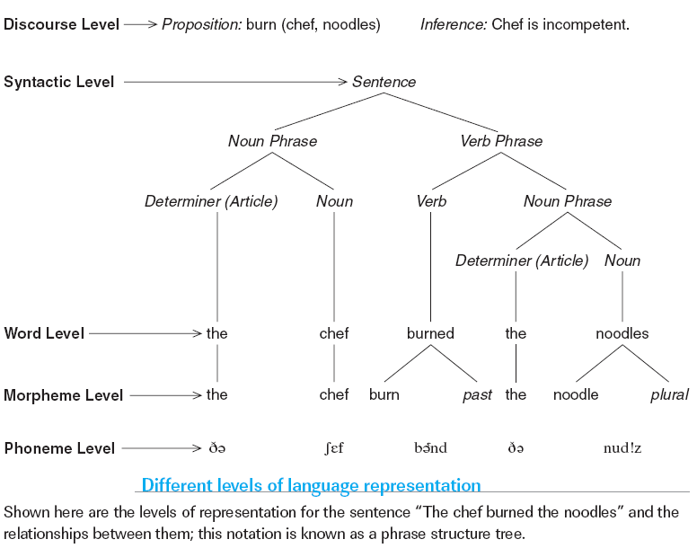
Levels of Language Representation
Chapter 12

Slide 4
Levels of Language Representation
Syntax, which specifies the relationships between the types of words in a sentence (such as between nouns and verbs); syntax is a way of representing sentence structure, and many psychologists and linguists believe that it is part of our mental representation of a sentence as well.
A standard way of representing the syntax of a sentence is a phrase structure tree, a diagram of a sentence that illustrates its linear and hierarchical structure.
Many linguists and psycholinguists believe that in the process of understanding a sentence, we build a mental representation of the tree’s hierarchical representation of word relationships, and that this process is a key step in determining the meaning of the sentence.
Chapter 12

Slide 5
Levels of Language Representation
Aphasia: a language or speech disruption (from Greek words meaning “without speech”).
Aphasia manifests itself in many different ways; one of them, which disrupts the syntactic level of representation, is called nonfluent aphasia.
Or Broca’s aphasia, named for the French physician Paul Broca (1824–1880), who first described an aphasic patient with damage to a left frontal area of the brain now known as Broca’s area.
Chapter 12

Slide 6
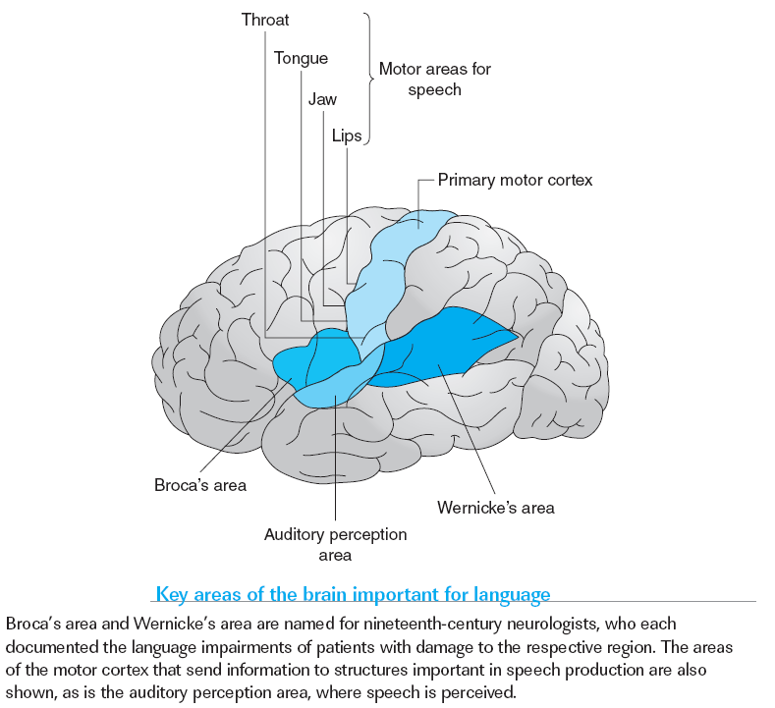
Levels of Language Representation
Chapter 12

Slide 7
Levels of Language Representation
Morphemes, the building blocks of words, are the smallest unit of meaning in a language.
Morphemes such as chef and burn that convey meaning but do not indicate much about the structure of the sentence are called content morphemes.
On the other hand, function words and function morphemes, such as the and the -ed past tense ending in English, convey less meaning, but convey a relatively large amount of information about relationships among words and about the syntactic structure of a sentence.
Chapter 12

Slide 8
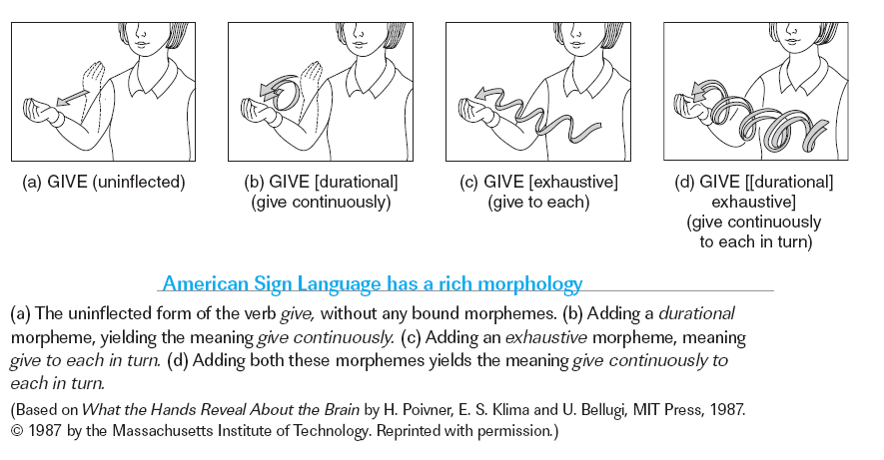
Levels of Language Representation
Chapter 12

Slide 9
Levels of Language Representation
Patients with Wernicke’s aphasia, also known as fluent aphasia, have a very different set of problems, which are at the word and morpheme levels.
This type of aphasia often results from damage to Wernicke’s area, which is named for Carl Wernicke (1848–1904), the Polish-German neurologist and psychiatrist who described a patient with damage to this area.
Patients with Wernicke’s aphasia have generally good use of function morphemes, and their speech is typically fairly grammatical, with nouns, verbs and other parts of speech generally in the correct places in the sentence.
Chapter 12

Slide 10
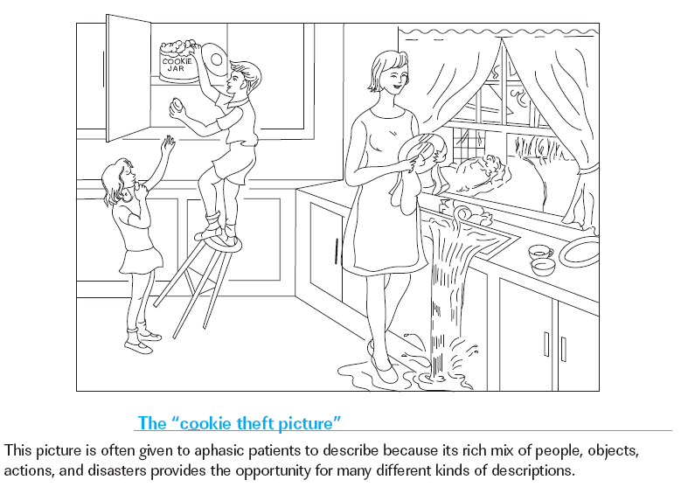
Levels of Language Representation
Chapter 12

Slide 11
Levels of Language Representation
Phonemes, the smallest distinguishable units of speech sound that make up the morphemes in a given language.
Spelling is not a precise enough system for representing speech sounds for a number of reasons.
A phonetic alphabet—in which the speech sounds of all languages can be represented, independent of how they are spelled in any word or writing system.
Chapter 12

Slide 12
Processes of Language Comprehension
The Triangle Model of the Lexicon
Ambiguity: A Pervasive Challenge to
Comprehension
Speech Perception
Representing Meaning
Sentence Comprehension
Figurative Language
Reading
Chapter 12

Slide 13
The Triangle Model of the Lexicon
Language researchers use the term lexicon to mean the entire set of mental representations of words.
Our mental representations are not lists of facts about a word’s pronunciation, part of speech, and meaning—and they are certainly not in alphabetic order, a key characteristic of dictionaries!
Producing language involves relating the meaning of a word to its sound representation for speaking it aloud, or to its spelling representation for writing.
Chapter 12

Slide 14
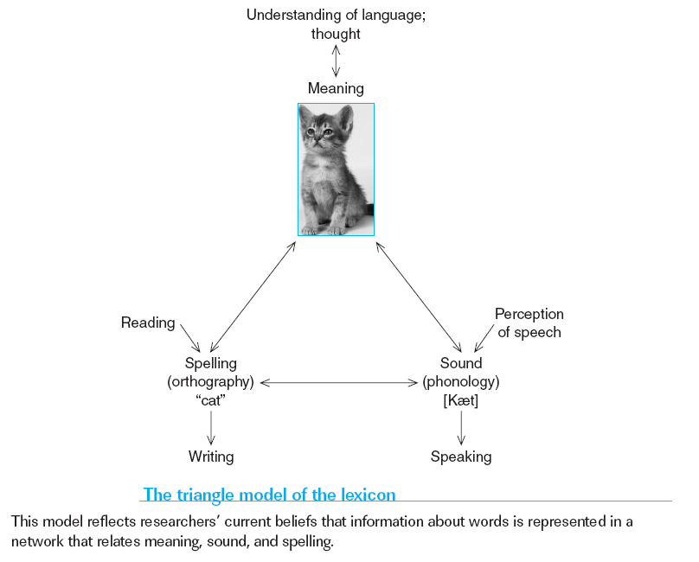
The Triangle Model of the Lexicon
Chapter 12

Slide 15
Ambiguity: A Pervasive Challenge to Comprehension
Another feature of language that contributes to the difficulty of relating different levels of linguistic representation is ambiguity, which in language is the property that permits more than one interpretation of a sound, word, phrase, or sentence.
Language carries a huge amount of ambiguity at every level and
the ambiguities at each of these levels have to be resolved before we can understand the meaning of what someone is saying.
Chapter 12

Slide 16
Ken Shot a Buck

Slide 17
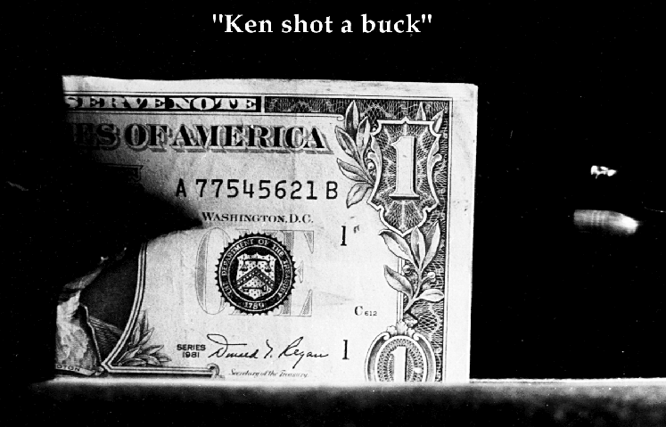

Slide 18
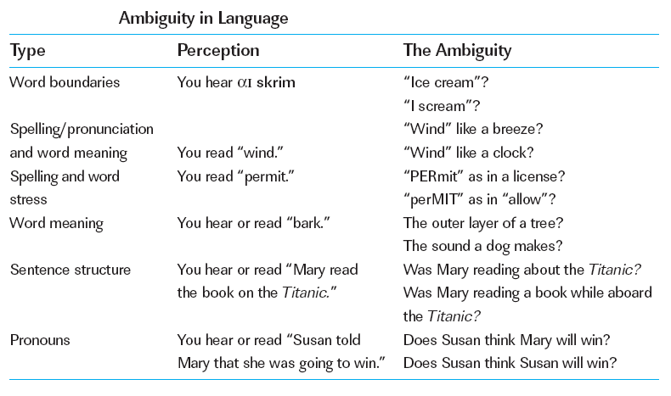
Ambiguity: A Pervasive Challenge to Comprehension
Chapter 12

Slide 19
Ambiguity
Semantic or syntactic:
  Billy went to the bank. (semantic)
    He cashed his paycheck.
    He caught 2 fish.
  The young bear…(syntactic)
    the responsibility to care for the old.
    ate Billy.
Notes:
Billy went to the bank. (semantic)
He cashed his paycheck.
He caught 2 fish.
Drinking games can be dangerous. (syntactic)
The young bear… (syntactic)
the responsibility to care for the old.
ate Billy.

Slide 20
Ambiguity
The horse raced past the barn fell.
The ship sailed past the island sank.
Garden path:
  Immediacy of interpretation
    Must commit to a meaning & phrase structure
  Minimal attachment
Notes:
Garden path: Parsing with the wrong phrase structure & having to go back
Immediacy of interpretation: supported by problems w/ above 2 examples
Minimal attachment: create the simplest phrase structure

Slide 21
Sentence Comprehension
Structural ambiguity: the linear string of words that is heard or read is consistent with more than one syntactic structure and sentence meaning.
Garden path sentence: the listener or reader is first “led down the garden path” to an incorrect interpretation before being allowed to reanalyze the sentence and find the correct interpretation.
Garden path sentences reveal a very basic property about sentence comprehension: its immediacy—we interpret words as we encounter them.
Chapter 12

Slide 22
Sentence Comprehension
The point in a sentence at which the structure and, therefore, the intended interpretation are made clear is known as the disambiguation region.
Observations of reading times in the disambiguation region can reveal comprehension difficulties caused by ambiguities.
Participants who read an ambiguous sentence and then encounter a disambiguation region that does not match their initial interpretation slow down in the disambiguation region (their eyes fixate on this region for an extended amount of time).
At this point they realize that they have been led down the garden path and have to reanalyze the sentence, which takes more time
Chapter 12

Slide 23
Speech Perception
A spectrogram is a two-dimensional visual display of speech in which time is shown on one axis, the frequency of the sound (which corresponds to pitch) on the other, and the intensity of the sound at each point of time and frequency is indicated by the darkness of the display (and thus white space indicates silence).
Articulation—the production of speech sounds— varies depending on the rate of speech, the speaker’s mood, and many other factors.
This overlapping of phonemes in speech is called coarticulation, and it has a large effect on the sound of each phoneme.
A badly articulated, or even missing, phoneme is supplied through the phoneme restoration effect.
Chapter 12

Slide 24
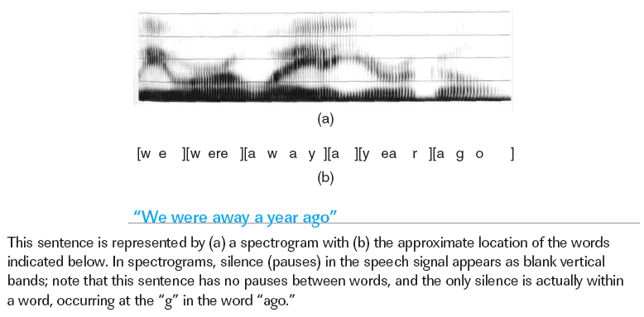
Speech Perception
Click here for A Closer Look
Chapter 12

Slide 25
Speech Perception
It is thought that much of the recognition component of integration works via an unconscious process of elimination in which we consider a number of possible words, called a cohort, that match the speech signal we hear, and then gradually weed out those that don’t match the available bottom-up or the top down information.
Speech researchers describe these differences in terms of neighborhood density, the number of similar sounding words in the language.
We have no conscious feeling that we are considering many possibilities during speech perception, but the cohort model suggests that the candidates in the cohort must evoke a greater degree of activation than words that are not considered.
Chapter 12

Slide 26
Speech Perception
Consider:
  Average speaker produces 15 sounds/second
  Phoneme production varies hugely (think New Jersey vs. West Texas)
  Context allows listeners to fill in missing sounds
  Visual cues (speaker’s lips) help understanding
  Listeners impose boundaries between sounds

Slide 27
Speech Perception
Phoneme Production
  Speakers vary in:
    Pitch
    Tone
    Rate of production
    Amount of slurring/distortion
    Combining (coarticulation)
      http://www.youtube.com/watch?v=j3r-dt3OpZc

Slide 28
Speech Perception: Context
Context of sentence helps disambiguate missing/distorted sounds
  Warren & Warren (1970)
  It was found that the *eel was on the axle.
  It was found that the *eel was on the shoe.
  It was found that the *eel was on the orange.
  It was found that the *eel was on the table.
Consequently, we often fail to notice mis-pronounciations
Notes:
parameters

Slide 29
Speech Perception: Visual Cues
Viewing speaker’s lips helps disambiguate sounds
McGurk Effect
Notes:
McGurk Effect

Slide 30

web demo of mcgurk effect

Slide 31
Speech Perception: Visual Cues
Problem for computer speech perception
  Some similar sounds can be easily discerned by viewing speaker’s lips
  Different sounds sometimes look the same

Slide 32
Speech Perception: Word Boundaries
Very often natural speech lacks clear-cut boundaries
But!
  Fluent speakers have no trouble hearing individual words
  Didyoueat?
  D’jeet?

Slide 33
Representing Meaning
Some evidence for this non-“dictionary” view of lexical meaning comes from studies of patients who have sustained damage to the temporal lobes of the brain.
Some of these patients have category-specific impairments, that is, they have more difficulty activating semantic representation for some categories than for others
Researchers who study these participants ask them to indicate the meaning of pictures, either by naming the object in the picture or in some other way, such as by choosing among a set of pictures in response to an instruction like “Point to the banana.”
Chapter 12

Slide 34
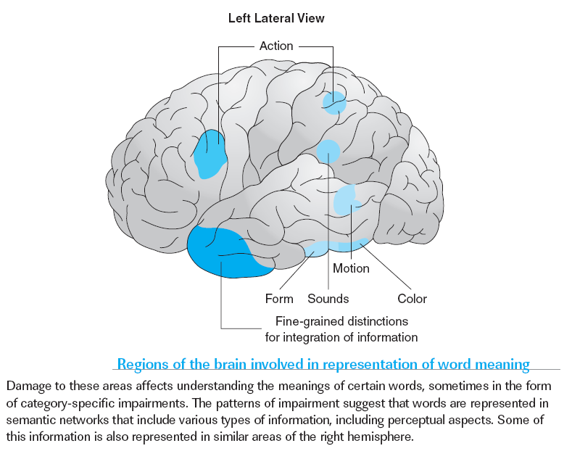
Representing Meaning
Chapter 12

Slide 35
Figurative Language
Figurative language is by definition ambiguous, in that it is the deliberate use of one word to mean another, by metaphor or simile.
Intonation: the “melody” of a sentence—the rise and fall of pitch, the variations in stress.
Sarcasm, irony, jokes, and some other types of figurative language often rely on intonation.
But the right hemisphere’s role in the interpretation of figurative language interpretation cannot rest entirely in fine grained analyses of intonation, given that it plays a similar role in the interpretation of spoken and written speech (and there is no intonation of written speech).
Chapter 12

